Slide 1



DataSpark Illuminating Insights for Global Electronics
View in Power BI
Last data refresh:
15/08/2024 16:00:55 UTC
Downloaded at:
15/08/2024 16:45:29 UTC

Slide 2
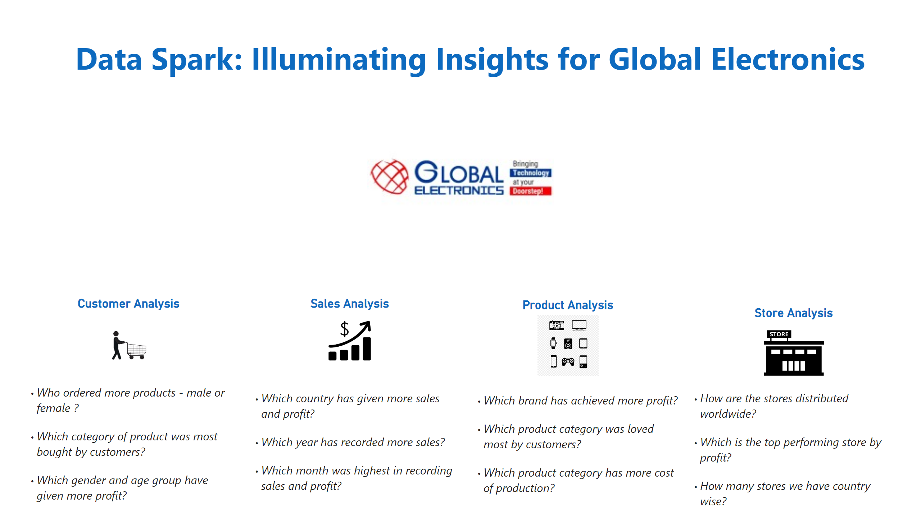
Overview
Notes:
textbox
No alt text provided
textbox
No alt text provided
textbox
No alt text provided
textbox
No alt text provided
textbox
No alt text provided
Customer Analysis
No alt text provided
Sales Analysis
No alt text provided
Store Analysis
No alt text provided
Product Analysis
No alt text provided
image
No alt text provided

Slide 3
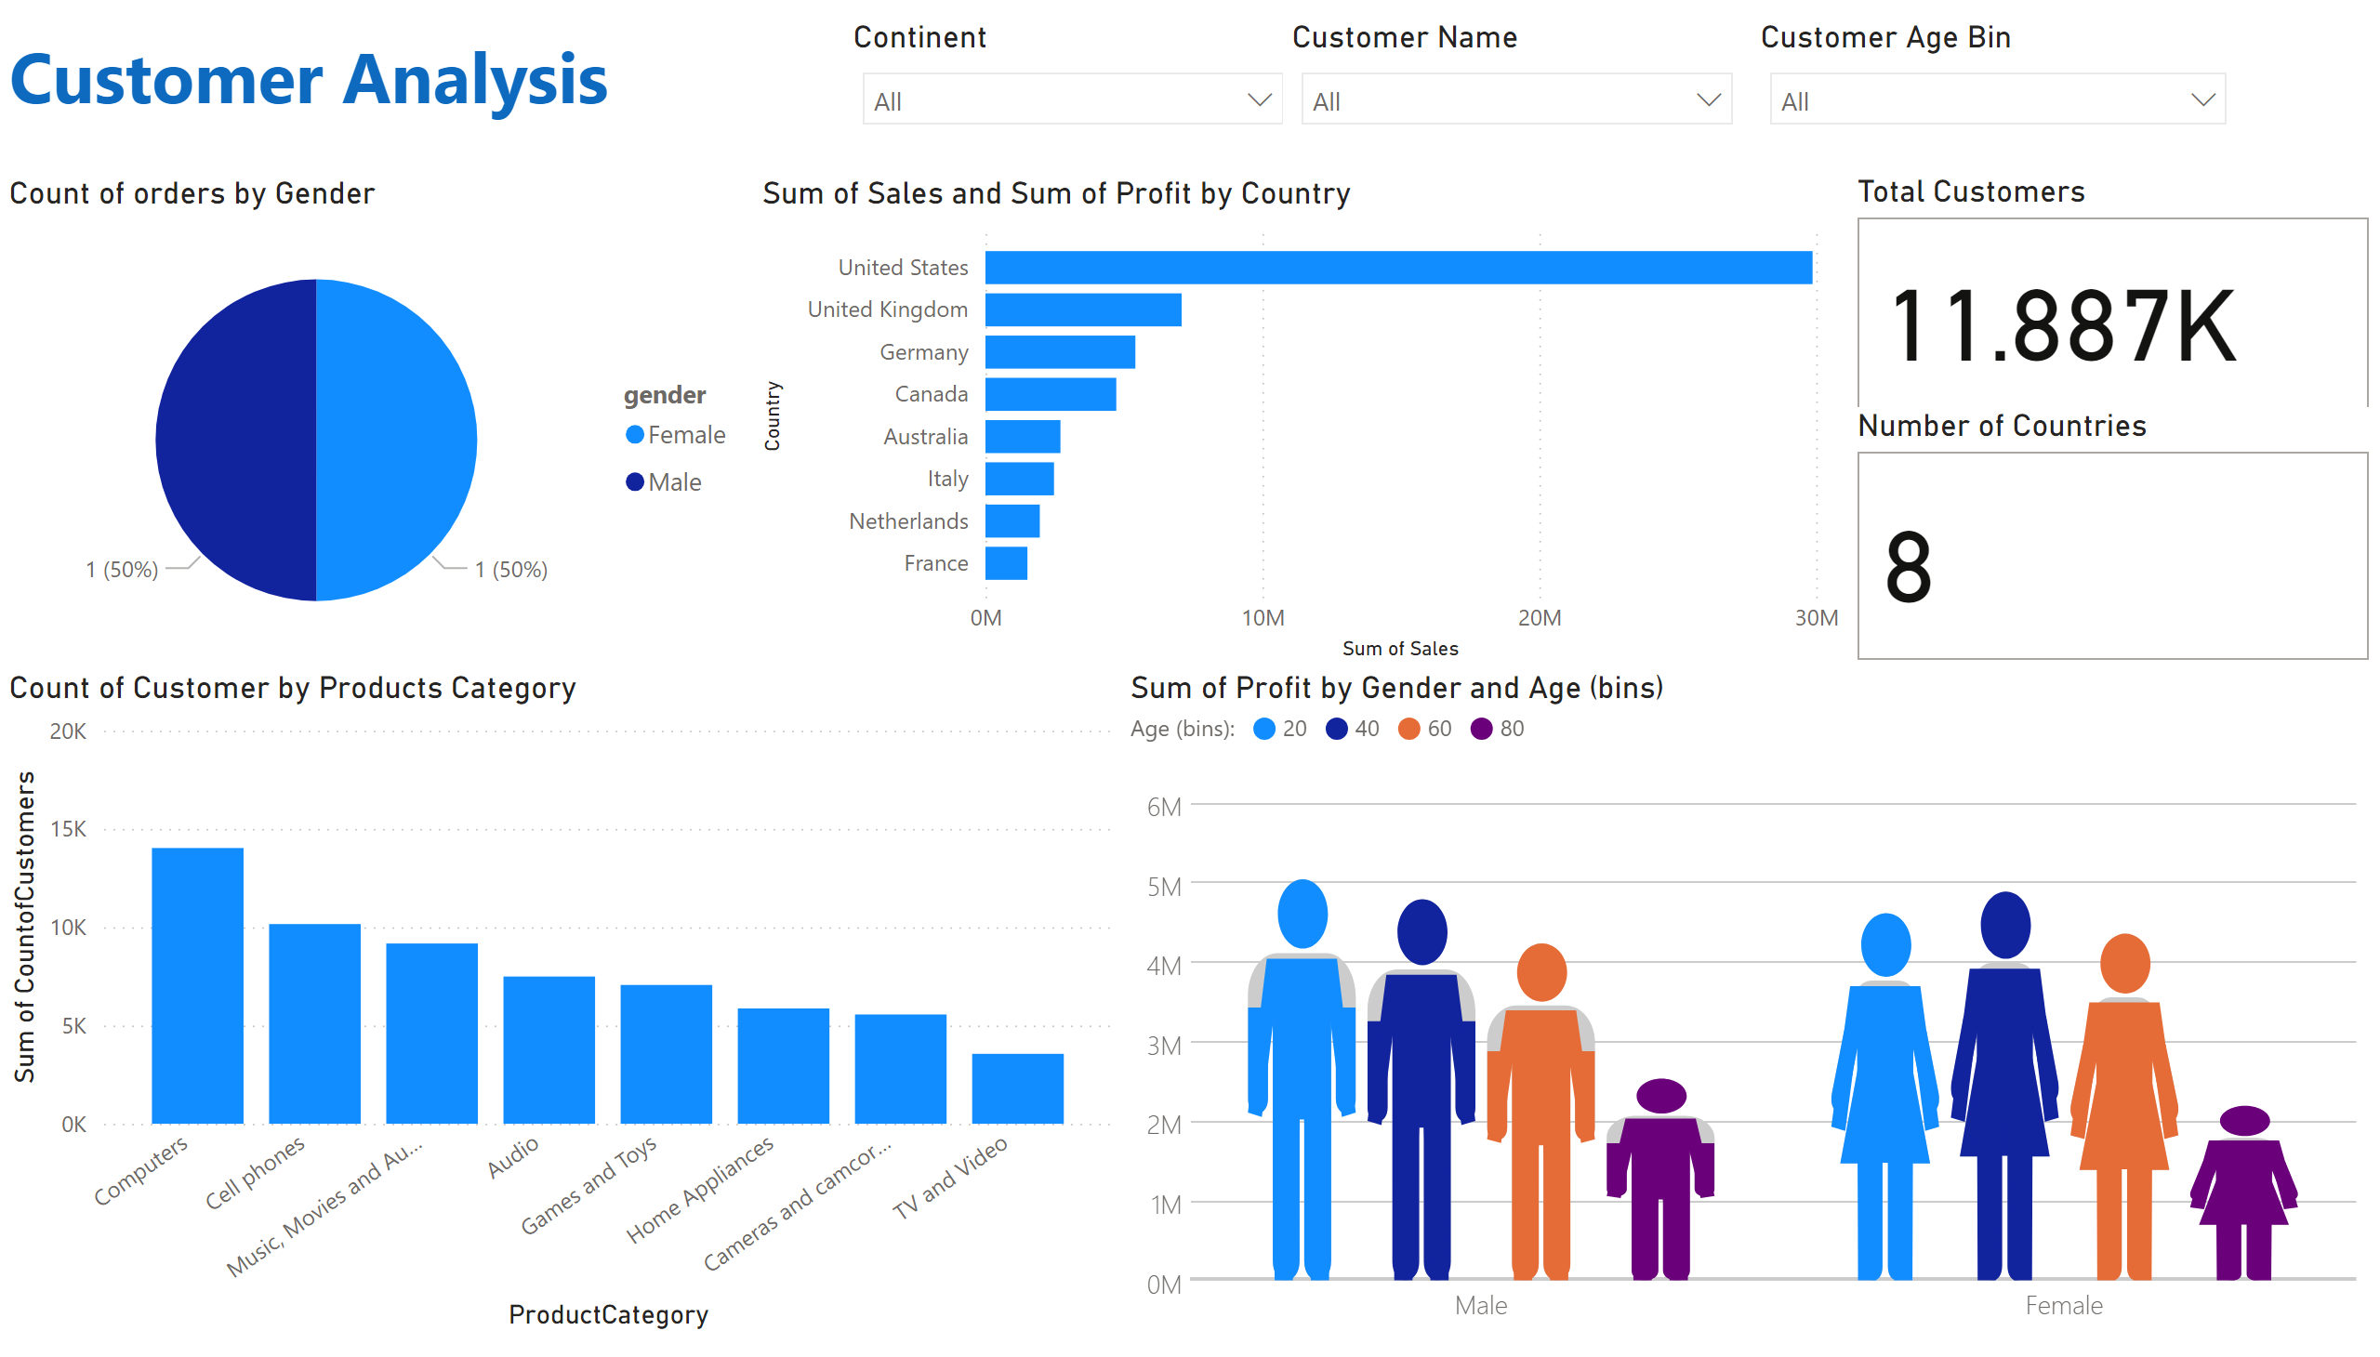
Customer_analysis
Notes:
Count of orders by Gender
No alt text provided
PBI_CV_73744D90_4DC9_4F18_8BA5_EE8FA5C98035
No alt text provided
clusteredBarChart
No alt text provided
Total Customers
No alt text provided
Count of Customer by Products Category
No alt text provided
Number of Countries
No alt text provided
textbox
No alt text provided
Continent
No alt text provided
Customer Name
No alt text provided
Customer Age Bin
No alt text provided

Slide 4
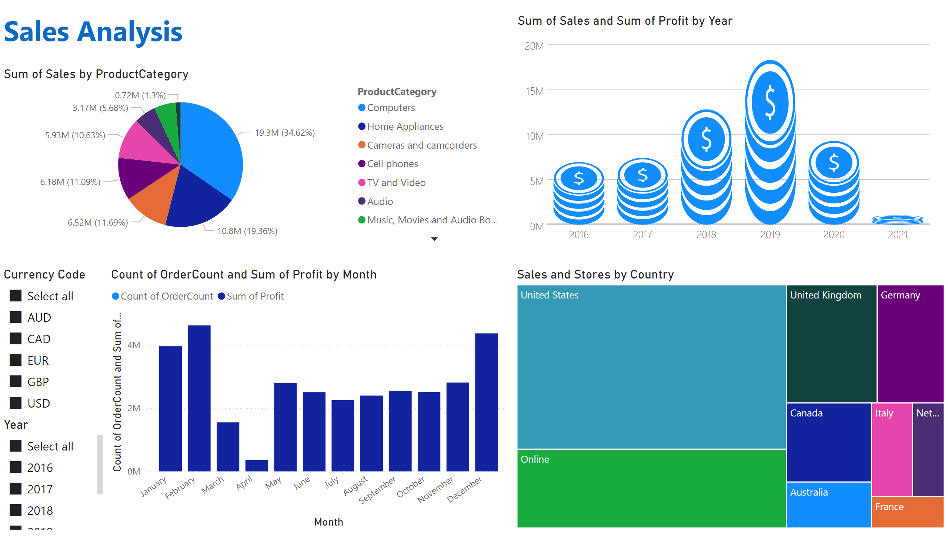
Sales_analysis
Notes:
pieChart
No alt text provided
Sales and Stores by Country
No alt text provided
PBI_CV_73744D90_4DC9_4F18_8BA5_EE8FA5C98035
No alt text provided
lineStackedColumnComboChart
No alt text provided
textbox
No alt text provided
Currency Code
No alt text provided
Year
No alt text provided

Slide 5
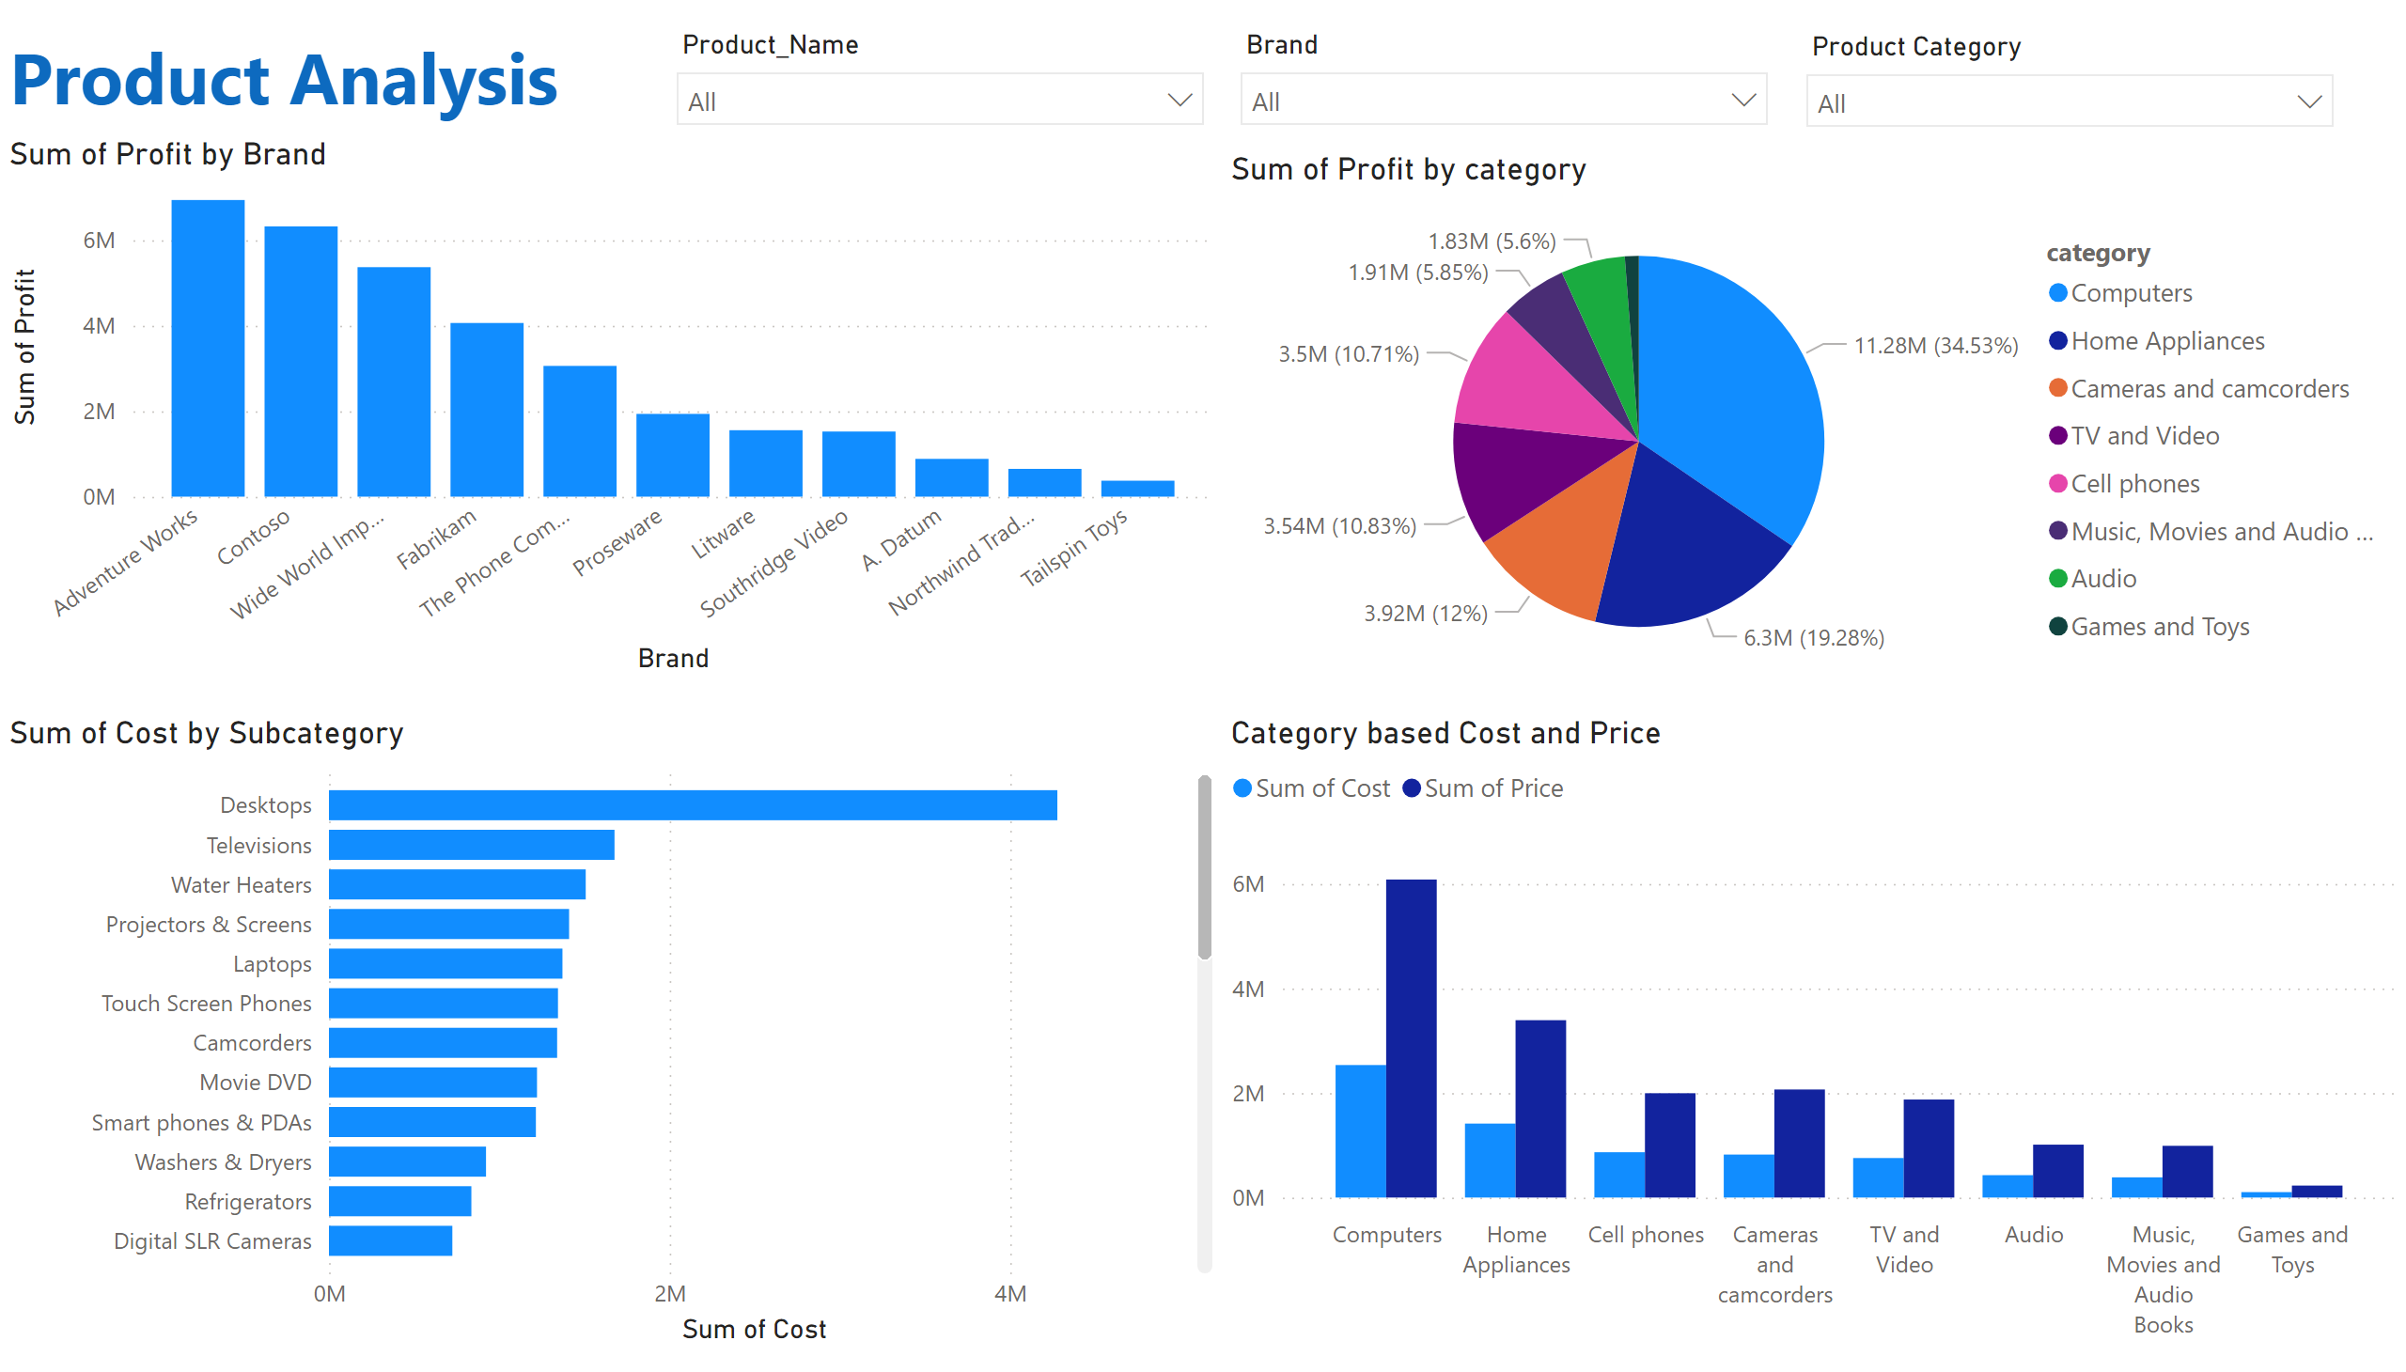
Product_analysis
Notes:
pieChart
No alt text provided
Sum of Profit by Brand
No alt text provided
Sum of Cost by Subcategory
No alt text provided
Category based Cost and Price
No alt text provided
textbox
No alt text provided
slicer
No alt text provided
slicer
No alt text provided
slicer
No alt text provided

Slide 6
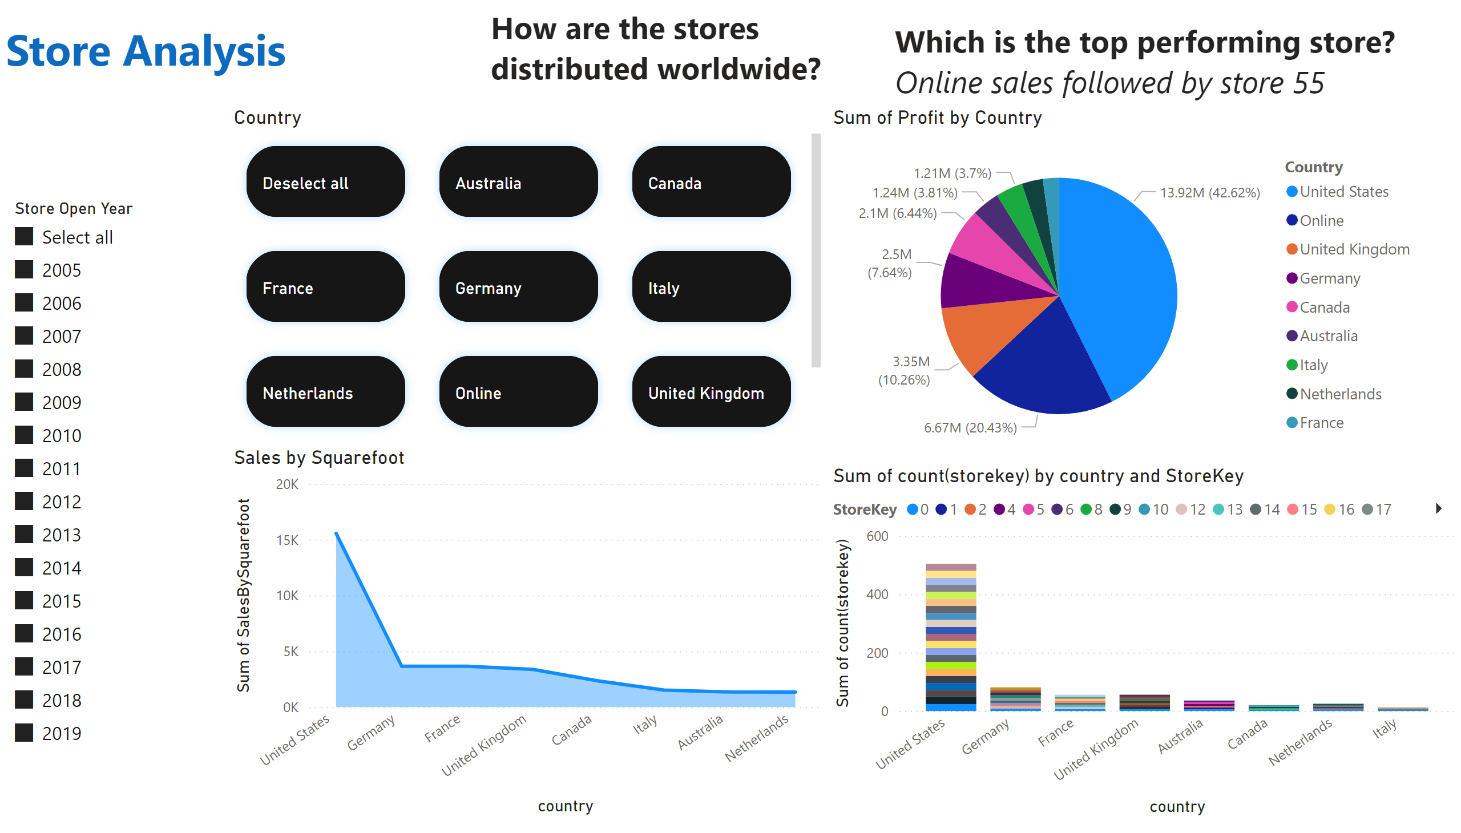
Store_analysis
Notes:
textbox
No alt text provided
textbox
No alt text provided
pieChart
No alt text provided
columnChart
No alt text provided
textbox
No alt text provided
Sales by Squarefoot
No alt text provided
advancedSlicerVisual
No alt text provided
slicer
No alt text provided

